Slide 1
Crime Hotspots
Using data and machine learning

Slide 2
Hotspots – where is crime going to occur
We know where crimes have occurred
We also know what venues such as bars, shops are near to those crime events
What if we could gain insights into what areas will be prone to crimes based solely on the kinds of nearby venues?

Slide 3
Hotspots – CRIME DATA
The country is split into police forces.
A police force is split into areas defined by a boundary
The crimes committed in that area can be obtained by Rest APIs from the central police database
We download the crime data for a period of months for each area
For a period of 9 months over 6000 unique crime events per area
The area is split into square cells – for each cell we search the crime events to see which occurred within a small distance from the cell’s center

Slide 4
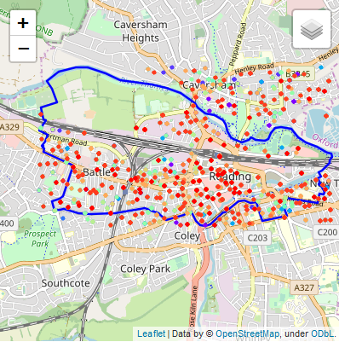
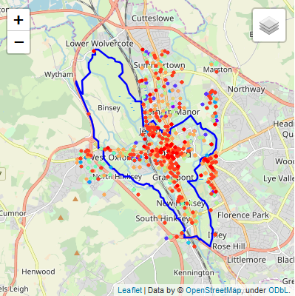
Determining hotspots (1)

Slide 5
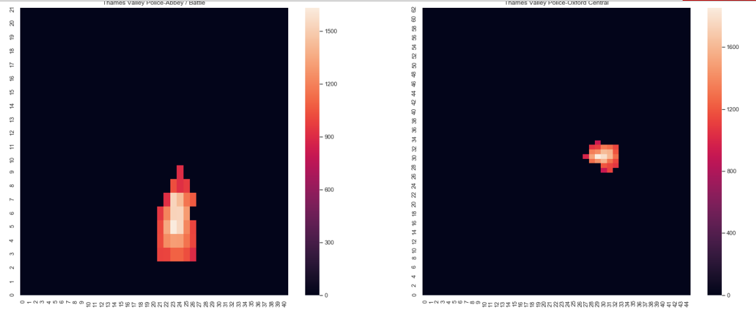
Determining hotspots (2)
For each cell add up the total crimes nearby.
If the total is above a threshold then that cell is a hotspot

Slide 6
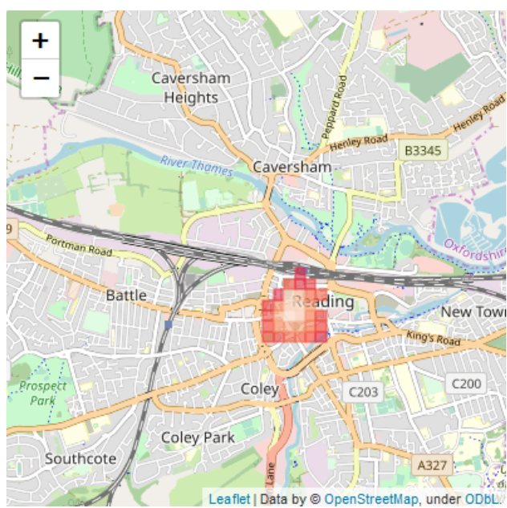
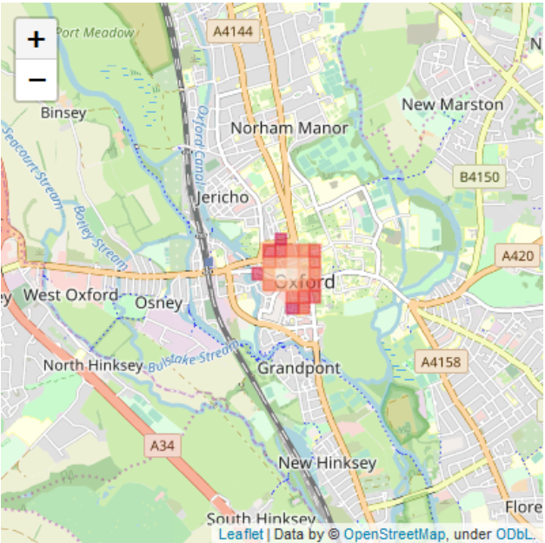
Determining hotspots (3)
For each cell add up the total crimes nearby.
If the total is above a threshold then that cell is a hotspot

Slide 7
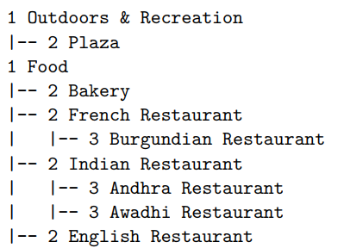
VENUE DATA
Each cell has a set of venues nearby.
Use the FourSquare API to find these.
Assign numerical levels to each venue category – enables an extract of categories for each level

Slide 8
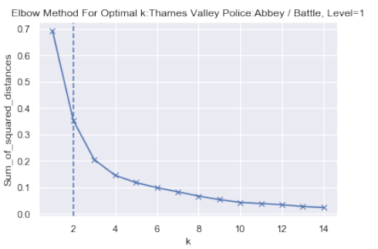
Optimal K-MEANS
Across the possible venue categories, use one-hot encoding and frequencies to create a table for the hotspots
Use K MEANS for clustering these venue frequencies across a range of cluster numbers
Use the elbow method, convexity, to determine the optimal K (cluster number) for each level

Slide 9
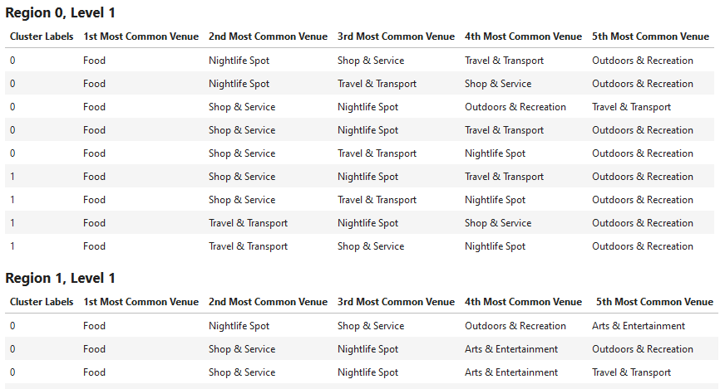
Analyse the clusters

